Slide 1
Gold Price Analysis using ARIMA AND Exponential Smoothing
- Tejaswi Gudimetla

Slide 2
INTRODUCTION
The main Objective is to apply ARIMA and Exponential Smoothing techniques to model and forecast monthly gold prices.
This dataset includes monthly gold prices from January 1950 to July 2020. Gold, valued as a precious metal, has been utilized as both a medium of exchange and a store of value for centuries and continues to be an important commodity in today’s financial markets. Prices of gold are influenced by various elements including global economic conditions, geopolitical events, and the dynamics of supply and demand.
The dataset consists of 847 entries, each representing the monthly price of gold measured in U.S. dollars per troy ounce. This data was obtained from the World Gold Council and extracted from Kaggle.

Slide 3
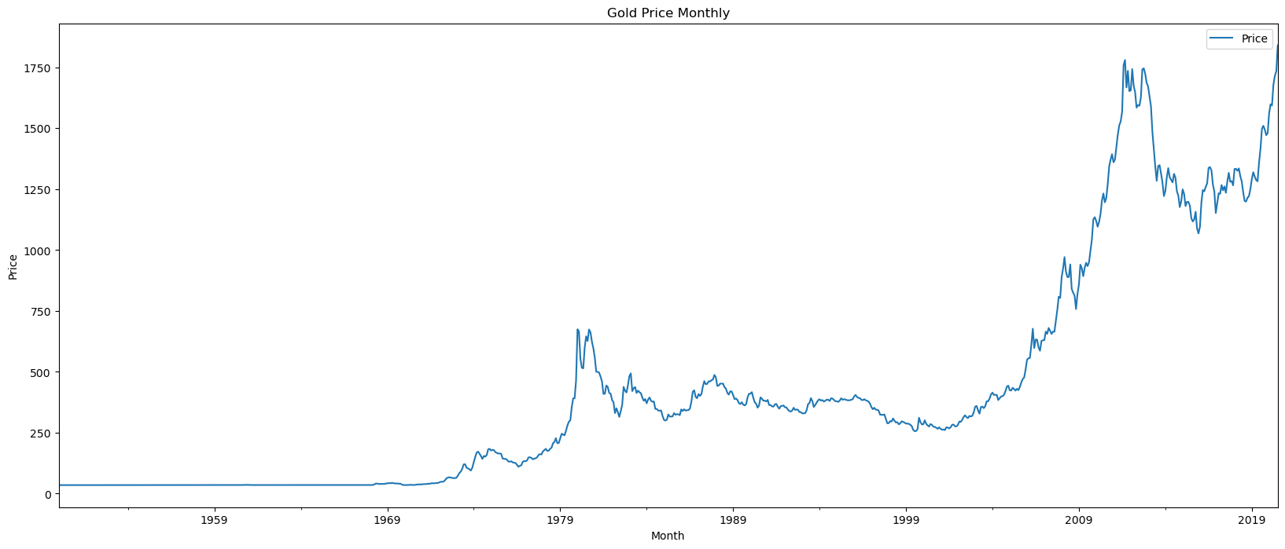
The plot shown in the image vividly illustrates the dramatic rise and fall of gold prices over the years. Notable is the sharp increase in prices post-2000, peaking around 2011-2012, which might correlate with global financial crises and subsequent recovery periods.

Slide 4
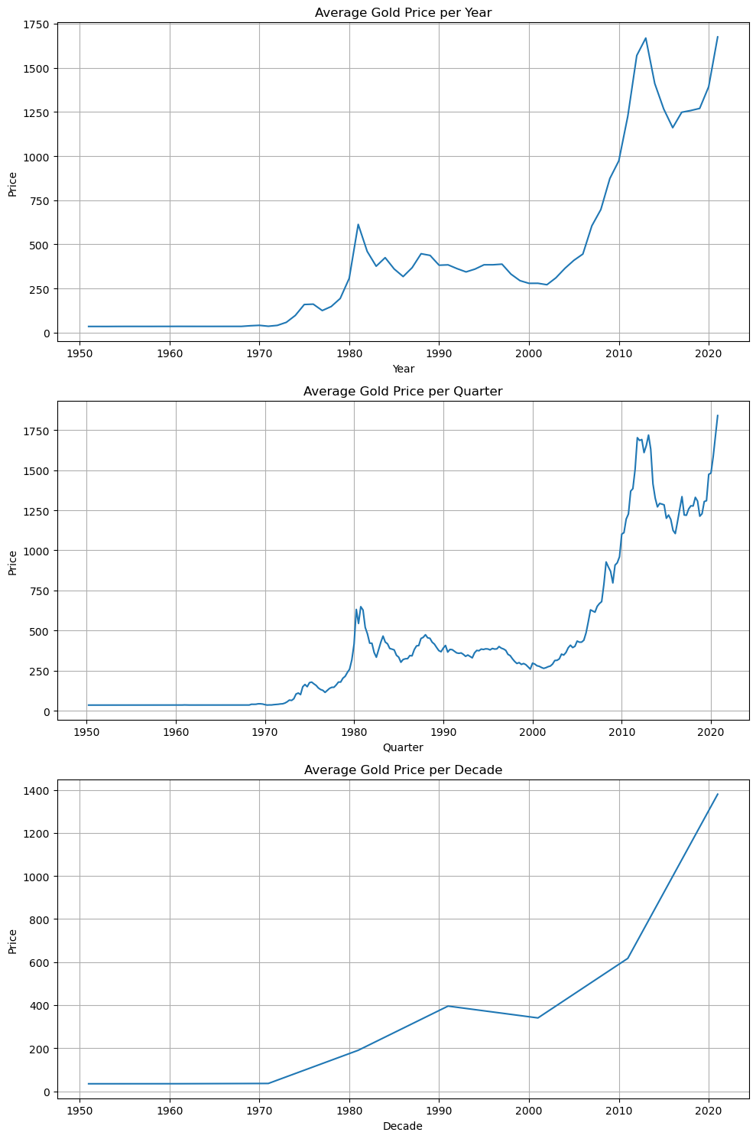
Year, Quarter and Decade plots for the dataset

Slide 5
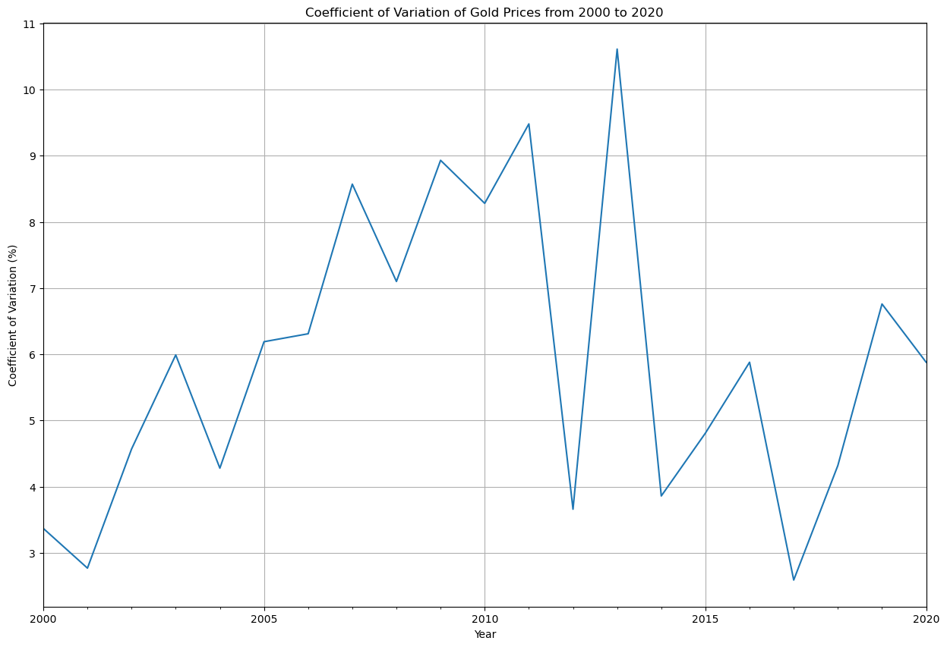
Plot for Coefficient of variation
The coefficient of variation (Cov) for gold prices from 2000 to 2020, presented in the graph, reveals significant fluctuations in price volatility relative to the average price each year. Peaks in the Cov graph correspond to periods of high economic uncertainty, where gold prices were particularly unstable. Conversely, lower Cov values indicate more stable pricing periods, suggesting lower risk for gold investors.

Slide 6
IMPLEMENTED MODELS
ARIMA MODEL
Theoretical Background:
ARIMA, or Autoregressive Integrated Moving Average, is a popular statistical method for time series forecasting that uses past values and past forecast errors to predict future values. It combines autoregressive (AR) models, moving averages (MA), and differencing (I) to make non-stationary data stationary.
Mathematical Representation:
AR (p): Refers to the number of lag observations included in the model. It is a component where the value of a variable depends on its own previous values.
I (d): Refers to the number of times the raw observations are differenced to make the series stationary.
MA (q): Incorporates the dependency between an observation and a residual error from a moving average model applied to lagged observations.
In terms of y, the general forecasting equation is:
ŷt = μ + ϕ1 yt-1 +…+ ϕp yt-p - θ1et-1 -…- θqet-q

Slide 7
EXPONENTIAL SMOOTHING MODEL
Theoretical Background and Mathematical Representation:
Exponential Smoothing is a time series forecasting method for univariate data that can be extended to support data with a trend and seasonal components. This method works by applying exponentially decreasing weights over time, which means that more recent observations are given more importance in forecasting than older observations. The method is well-suited for forecasting data with no clear trend or seasonal pattern, and it adapts well to changes in the trend and seasonality of historical data.
Simple Exponential Smoothing:
Simple Exponential Smoothing is used for forecasting time series data without a clear trend or seasonality, applying exponentially decreasing weights to older observations. It relies on a single smoothing parameter α to update the level of the series based on the most recent observation.
The single exponential smoothing formula is given by:
st = αxt+(1 – α)st-1 = st-1 + α(xt – st-1)

Slide 8
Holt’s Linear Trend Model (Double Exponential Smoothing):
This model extends Simple Exponential Smoothing to capture linear trends in the data by introducing a second equation to smooth the trend component. It uses two parameters, α for the level and
𝛽 for the trend, effectively separating the forecasting equation into level and slope.
The double exponential smoothing formulas are given by:
S1 = x1, B1 = x1-x0
For t>1,
st = αxt + (1 – α)(st-1 + bt-1) , βt = β(st – st-1) + (1 – β)bt-1
Here,
st = smoothed statistic, it is the simple weighted average of current observation xt
st-1 = previous smoothed statistic
α = smoothing factor of data; 0 < α < 1
t = time period
bt = best estimate of trend at time t
β = trend smoothing factor; 0 < β <1

Slide 9
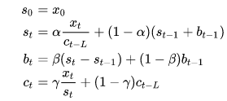
Holt-Winters Seasonal Model (Triple Exponential Smoothing):
Designed to handle data with trends and seasonality, this model incorporates three smoothing equations: one each for the level, trend, and seasonal component. It adjusts the forecast to account for patterns repeating every s periods, making it highly effective for seasonal time series.
Here,
st = smoothed statistic, it is the simple weighted average of current observation xt
st-1 = previous smoothed statistic
α = smoothing factor of data; 0 < α < 1
t = time period
bt = best estimate of a trend at time t
β = trend smoothing factor; 0 < β <1
ct = sequence of seasonal correction factor at time t
γ = seasonal change smoothing factor; 0 < γ < 1

Slide 10
OBSERVATIONS:
The comparative analysis of the ARIMA and Exponential Smoothing models through both MAPE (Mean Absolute Percentage Error) values reveals that ARIMA outperforms Exponential Smoothing for this specific dataset on gold prices. The ARIMA model's MAPE of 8.382% indicates higher accuracy compared to the 17.235% MAPE of the Exponential Smoothing model.
Future Predicted Values of ARIMA Model:
2020-08-31 1857.333553
2020-09-30 1848.411820
2020-10-31 1853.228149
2020-11-30 1850.628091
2020-12-31 1852.031712
2021-01-31 1851.273978

Slide 11
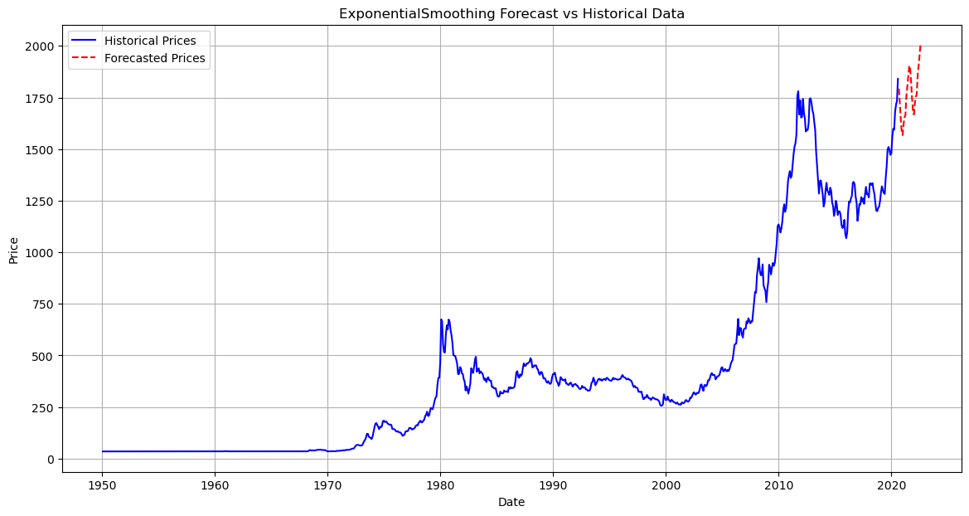
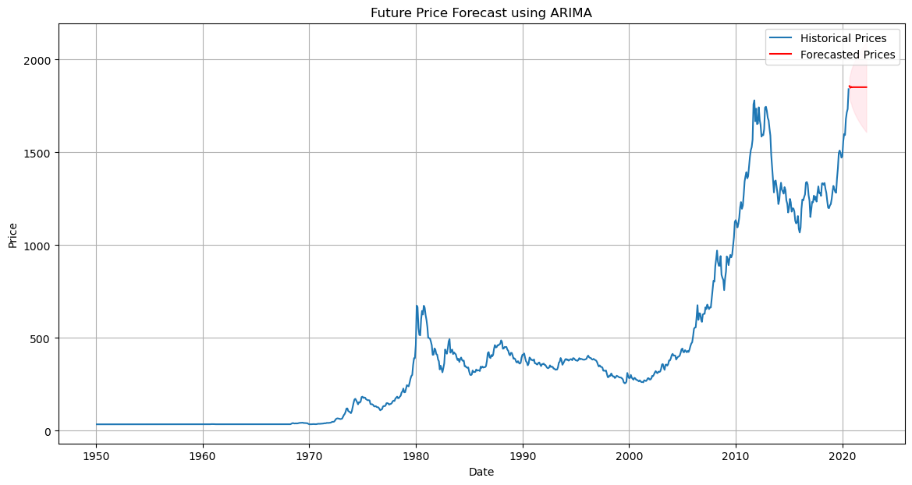
Visually, the ARIMA plot demonstrates a closer adherence to the historical data trends and smoother transitions into forecasted values, capturing the intricate movements of gold prices more effectively than Exponential Smoothing. This suggests that for data with complex, non-seasonal patterns, ARIMA provides a more reliable forecasting approach, making it a preferable choice.

Slide 12
THANK YOU!!

